Slide 1
An Introduction to Apache Spark

Slide 2
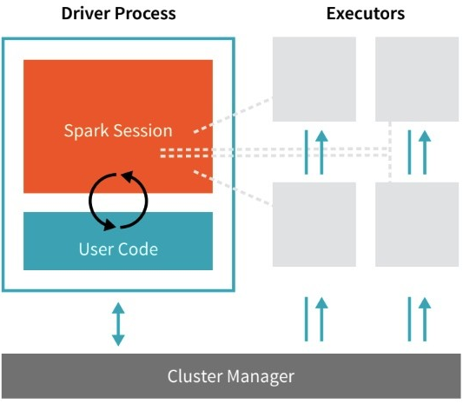
Spark Architecture

Slide 3
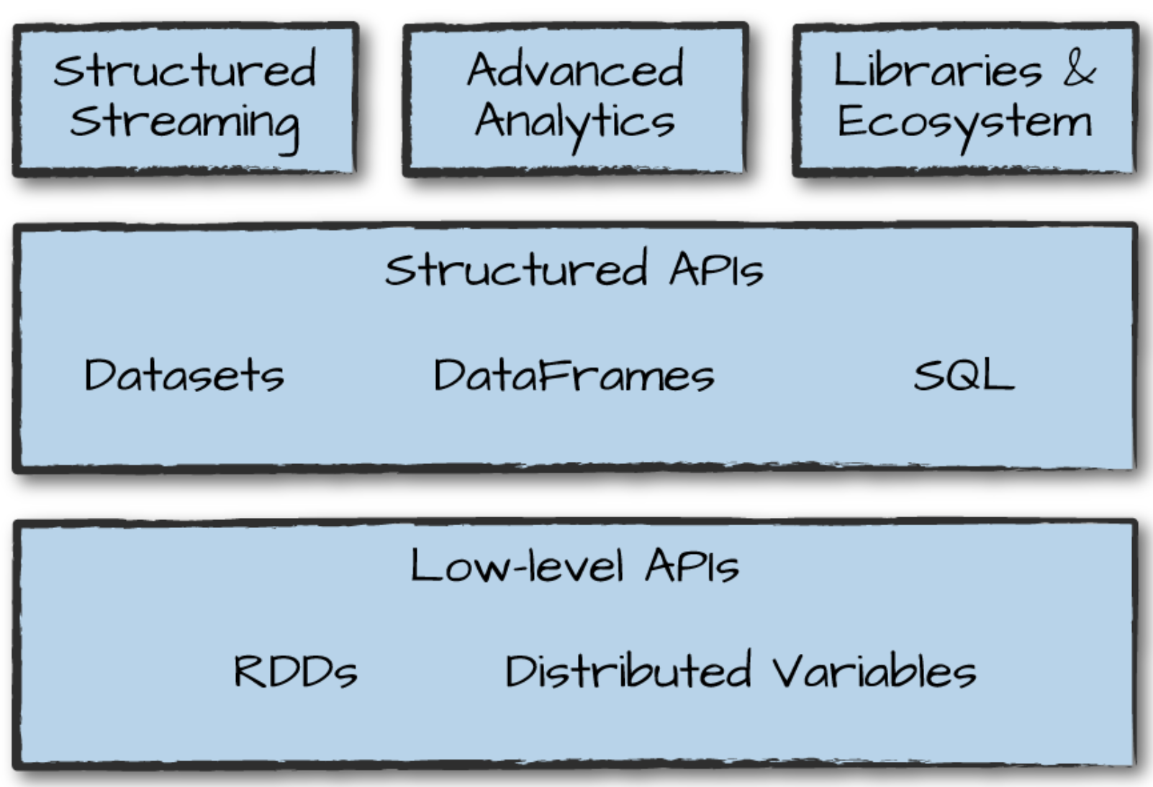
Spark’s Language APIs

Slide 4
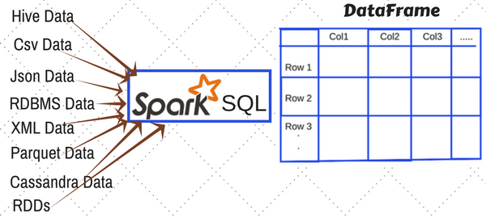
Ways to create DataFrame in Spark

Slide 5
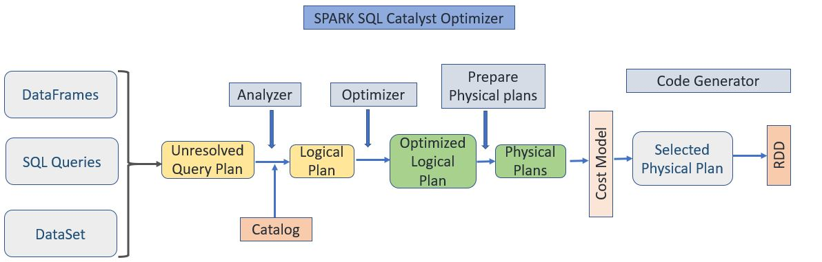
Spark Optimization

Slide 6
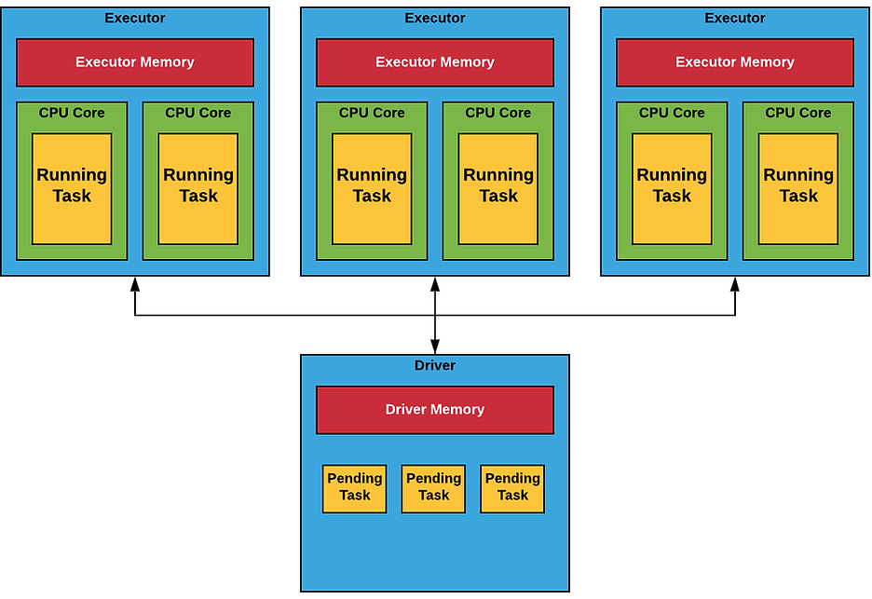
Spark Executor / Cores / Memory

Slide 7
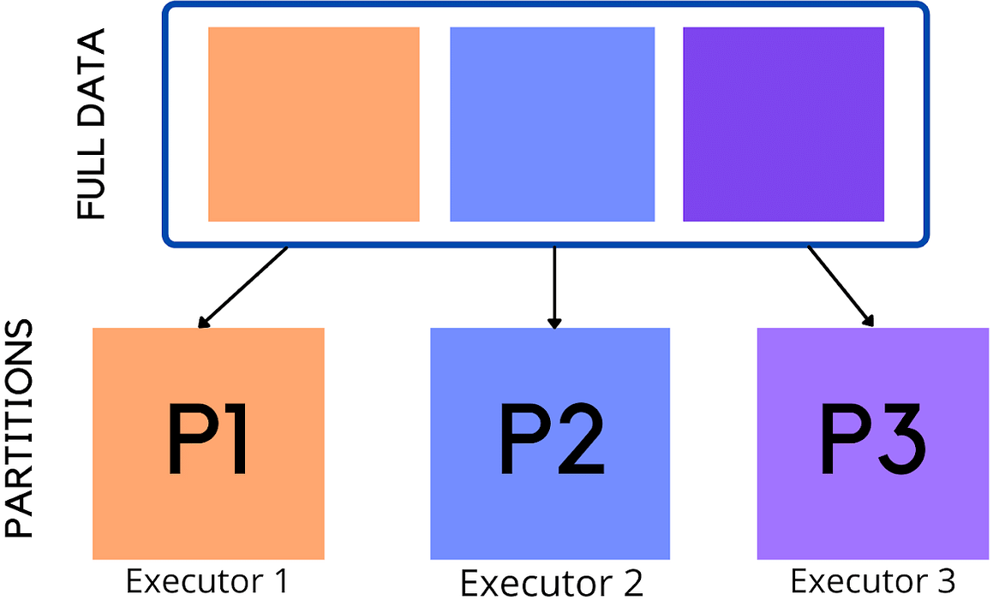
Partition and Executor
Notes:
Once the user has submitted his job into the cluster, each partition is sent to a specific executor for further processing
Only one partition is processed by one executor at a time

Slide 8
Repartitioning
The data in the cluster will be split.
Repartition involves a full shuffle
Coalesce reduces the number of partitions and avoids a full shuffle

Slide 9

Partitioning on input stage
When Spark reads a file from HDFS, it creates a single partition for a single input split
Notes:
If data is not explodable then Spark will use the default number of partitions
When a job starts the number of partitions is equal to the total number of cores on all executor nodes.
spark.default.parallelism: defaults to the number of all cores on all machines

Slide 10
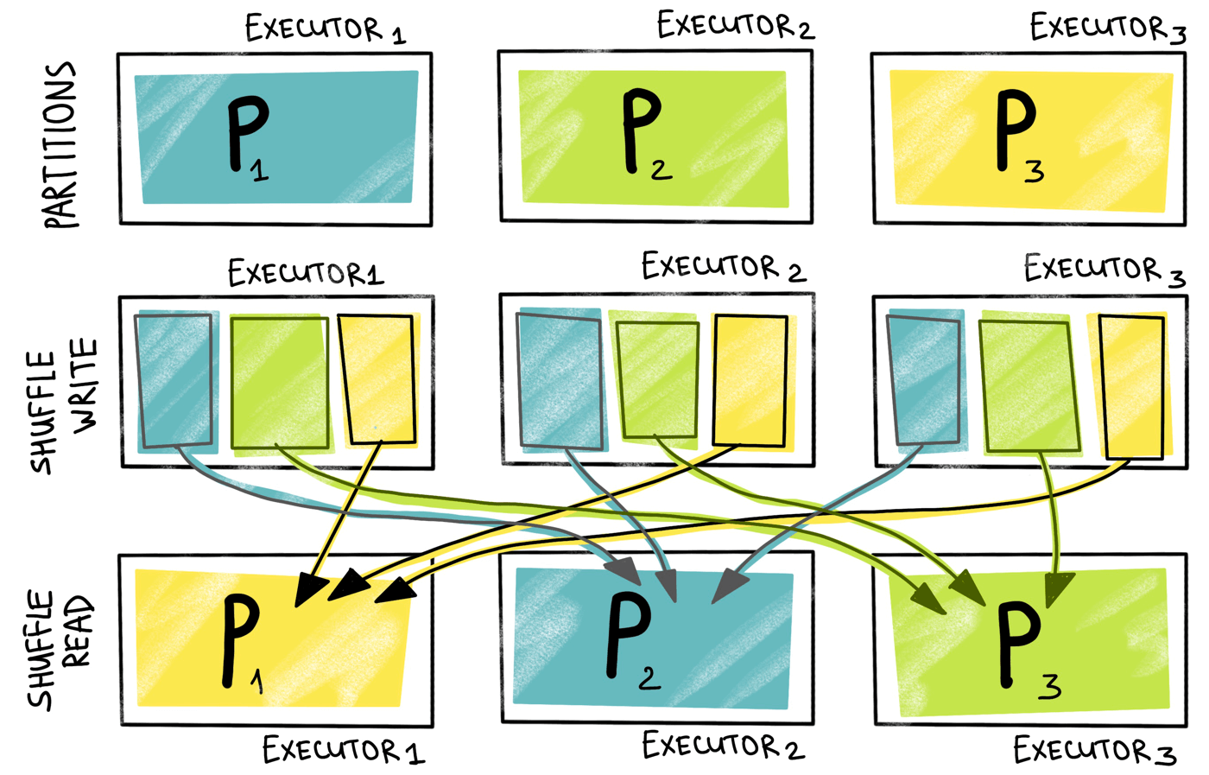
Shuffle partitioning
Notes:
Used at data shuffle for wide transformations
For wide transformations, the number of shuffle partitions is set to 200
spark.sql.shuffle.partitions

Slide 11
Output partitioning
Saving the partitioned data on the properly selected condition can significantly speed up the reading and retrieval of data
Notes:
https://luminousmen.com/post/spark-partitions

Slide 12
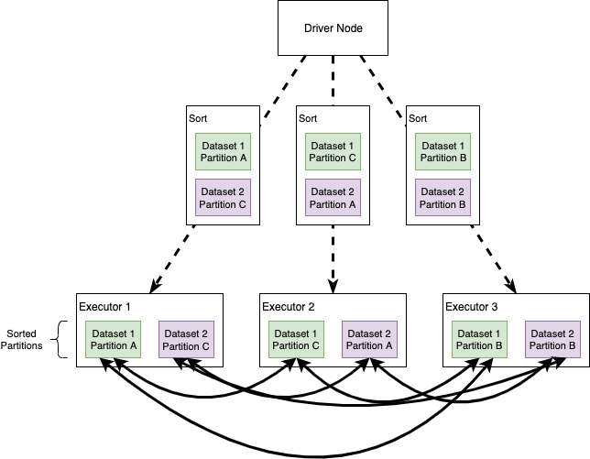
Sort Merge Join

Slide 13
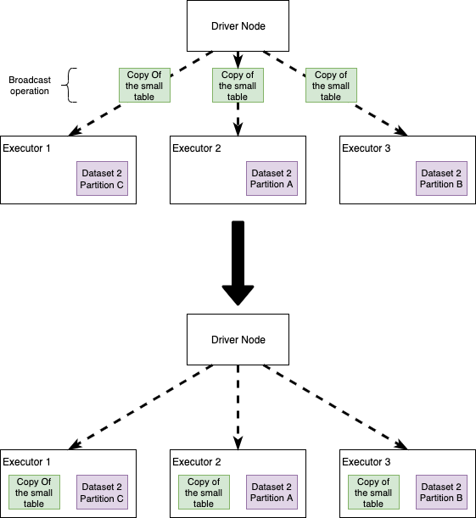
Broadcast Join
Notes:
Reference: https://itnext.io/apache-spark-internals-tips-and-optimizations-8c3cad527ea2s

Slide 14
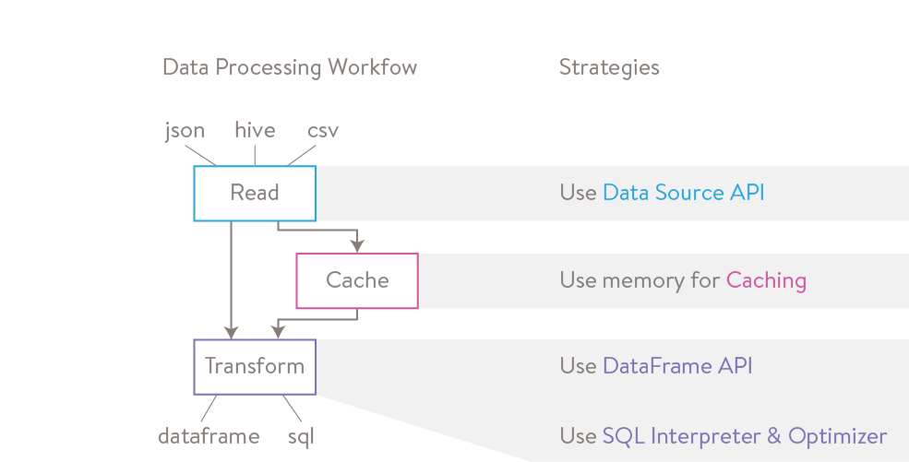
Caching

Slide 15
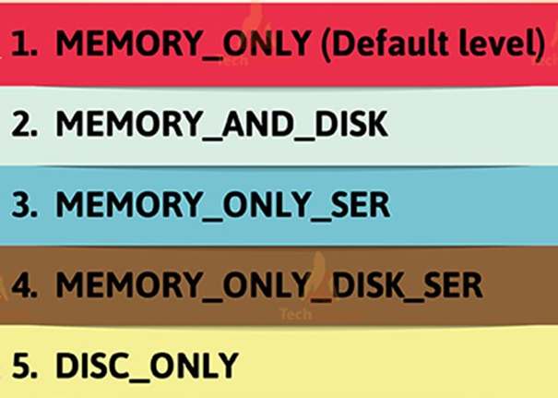
Caching Storage Levels

Slide 16
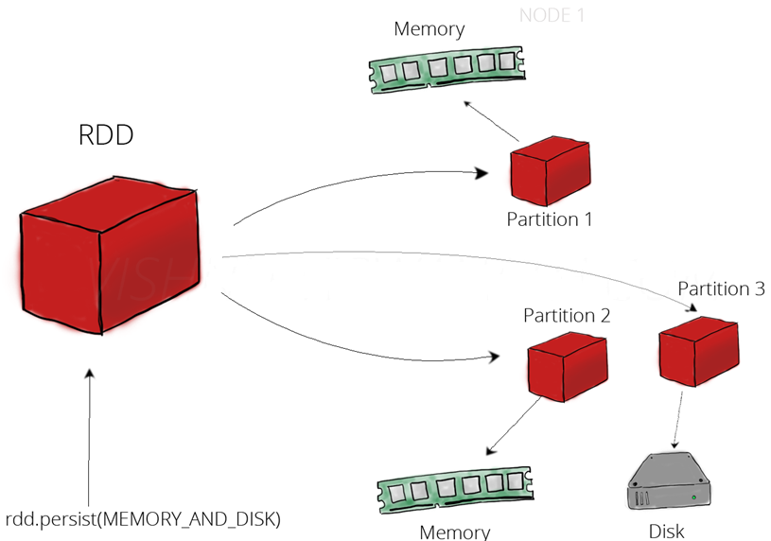
MEMORY_AND_DISK

Slide 17
MEMORY_ONLY_SER
Store RDD as serialized Java objects
More space-efficient

Slide 18
MEMORY_AND_DISK_SER
Spill partitions that don't fit in memory to disk

Slide 19
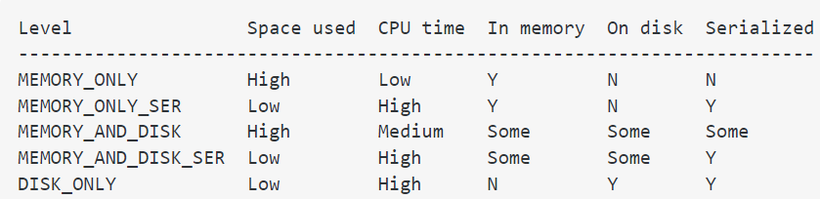
Caching Storage Levels

Slide 20
Unpersist RDD
Spark drop out the old data partition in the LRU (least recently used) fashion.
LRU is an algorithm which ensures the least frequently used data
Can also remove the cache manually using:
.unpersist()

Slide 21
Which Storage Level to Choose?
If data fit comfortably with the default storage level (MEMORY_ONLY), leave them that way.
If not, try using MEMORY_ONLY_SER
Use the replicated storage levels if you want fast fault recovery

Slide 22
Thanks

